Slide 1
Chapter 18
Superposition and Standing Waves

Slide 2
Waves vs. Particles
Waves are very different from particles.
Particles have zero size. | Waves have a characteristic size – their wavelength.
Multiple particles must exist at different locations. | Multiple waves can combine at one point in the same medium – they can be present at the same location.
Introduction

Slide 3
Quantization
When waves are combined in systems with boundary conditions, only certain allowed frequencies can exist.
  We say the frequencies are quantized.
  Quantization is at the heart of quantum mechanics, studied later
The analysis of waves under boundary conditions explains many quantum phenomena.
Quantization can be used to understand the behavior of the wide array of musical instruments that are based on strings and air columns.
Waves can also combine when they have different frequencies.
Introduction

Slide 4
Superposition Principle
Waves can be combined in the same location in space.
To analyze these wave combinations, use the superposition principle:
If two or more traveling waves are moving through a medium, the resultant value of the wave function at any point is the algebraic sum of the values of the wave functions of the individual waves.
Waves that obey the superposition principle are linear waves.
  For mechanical waves, linear waves have amplitudes much smaller than their wavelengths.
Section 18.1

Slide 5
Superposition and Interference
Two traveling waves can pass through each other without being destroyed or altered.
  A consequence of the superposition principle.
The combination of separate waves in the same region of space to produce a resultant wave is called interference.
  The term interference has a very specific usage in physics.
  It means waves pass through each other.
Section 18.1

Slide 6
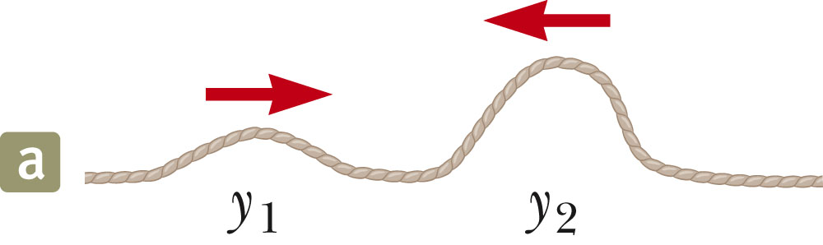
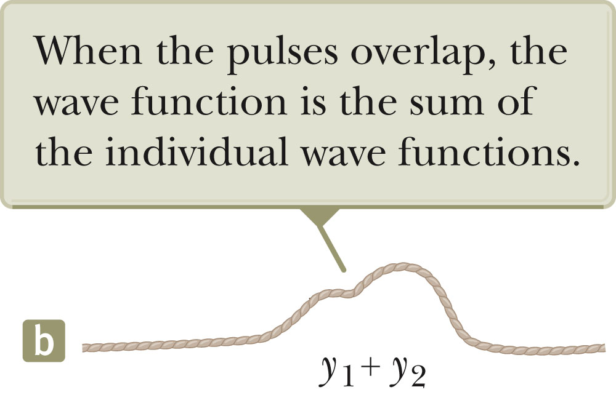
Superposition Example
Two pulses are traveling in opposite directions (a).
  The wave function of the pulse moving to the right is y₁ and for the one moving to the left is y_{2.}
The pulses have the same speed but different shapes.
The displacement of the elements is positive for both.
When the waves start to overlap (b), the resultant wave function is y₁ + y_{2.}
Section 18.1

Slide 7
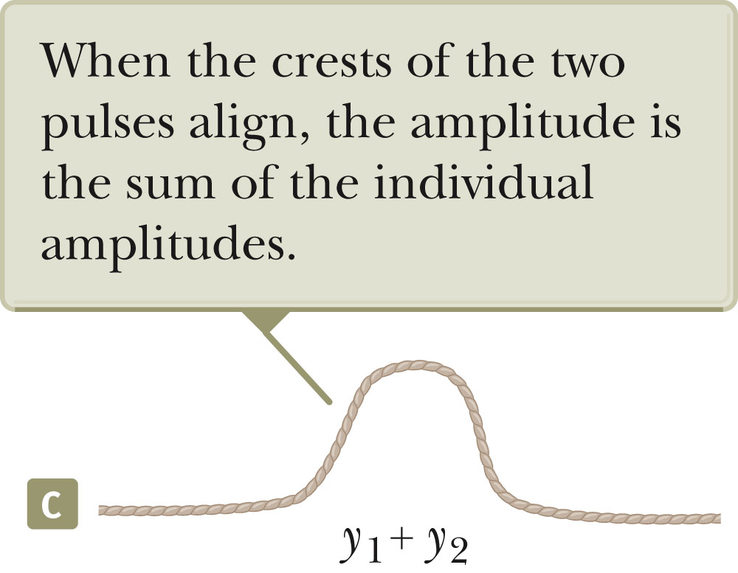
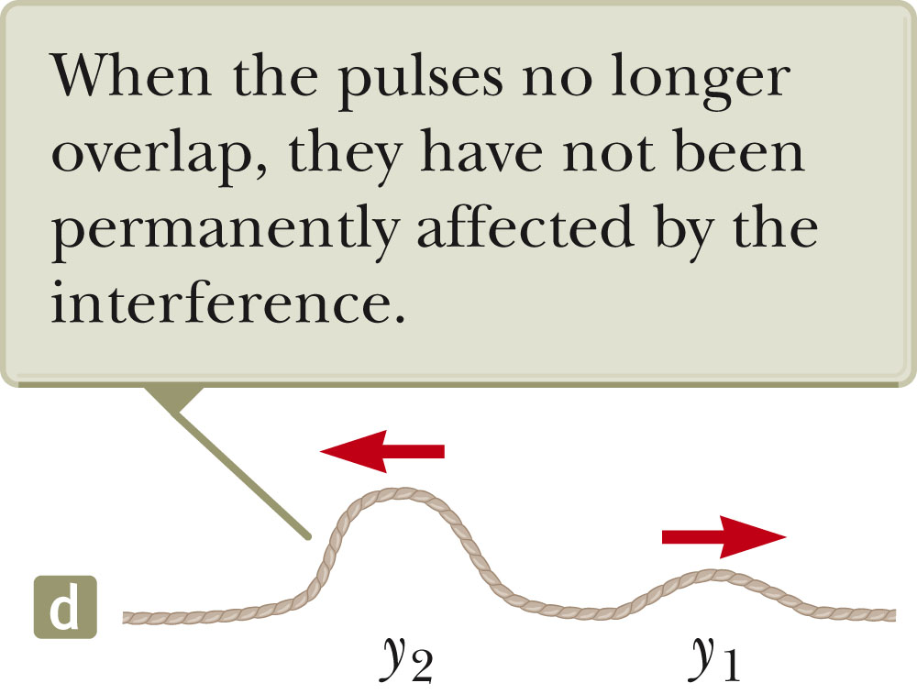
Superposition Example, cont
When crest meets crest (c) the resultant wave has a larger amplitude than either of the original waves.
The two pulses separate (d).
  They continue moving in their original directions.
  The shapes of the pulses remain unchanged.
This type of superposition is called constructive interference.
Section 18.1

Slide 8
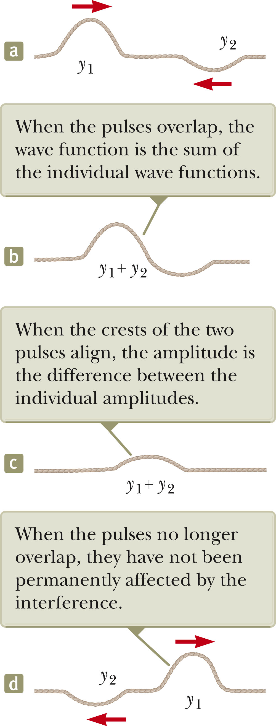
Destructive Interference Example
Two pulses traveling in opposite directions.
Their displacements are inverted with respect to each other.
When these pulses overlap, the resultant pulse is y₁ + y_{2.}
This type of superposition is called destructive interference.
Section 18.1

Slide 9
Types of Interference, Summary
Constructive interference occurs when the displacements caused by the two pulses are in the same direction.
  The amplitude of the resultant pulse is greater than either individual pulse.
Destructive interference occurs when the displacements caused by the two pulses are in opposite directions.
  The amplitude of the resultant pulse is less than either individual pulse.
Section 18.1

Slide 10
Analysis Model
The superposition principle is the centerpiece of the analysis model called waves in interference.
Applies in many situations
  They exhibit interesting phenomena with practical applications.
Section 18.1

Slide 11
Superposition of Sinusoidal Waves
Assume two waves are traveling in the same direction in a linear medium, with the same frequency, wavelength and amplitude.
The waves differ only in phase:
  y₁ = A sin (kx - ωt)
  y₂ = A sin (kx - ωt + φ)
  y = y₁+y₂ = 2A cos (φ /2) sin (kx - ωt + φ /2)
The resultant wave function, y, is also sinusoida.l
The resultant wave has the same frequency and wavelength as the original waves.
The amplitude of the resultant wave is 2A cos (φ / 2) .
The phase of the resultant wave is φ / 2.

Slide 12
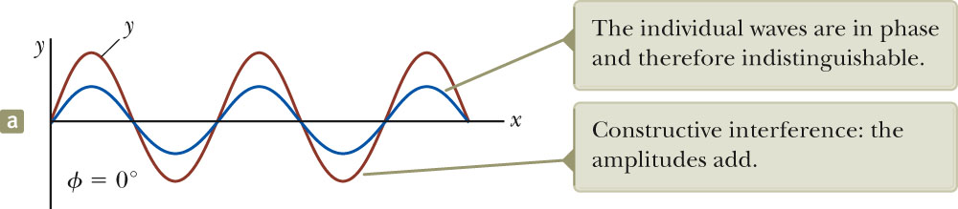
Sinusoidal Waves with Constructive Interference
When φ = 0, then cos (φ/2) = 1
The amplitude of the resultant wave is 2A.
  The crests of the two waves are at the same location in space.
The waves are everywhere in phase.
The waves interfere constructively.
In general, constructive interference occurs when cos (Φ/2) = ± 1.
  That is, when Φ = 0, π, 2 π, … rad
    When Φ is an even multiple of π
Section 18.1

Slide 13
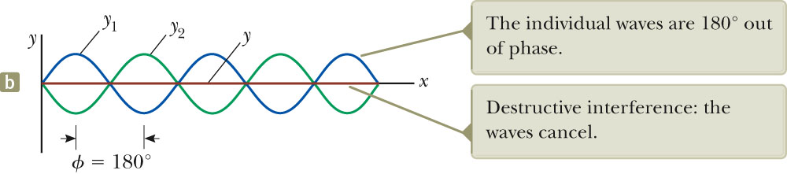
Sinusoidal Waves with Destructive Interference
When φ = π, then cos (φ/2) = 0
  Also any odd multiple of π
The amplitude of the resultant wave is 0.
  See the straight red-brown line in the figure.
The waves interfere destructively.
Section 18.1

Slide 14
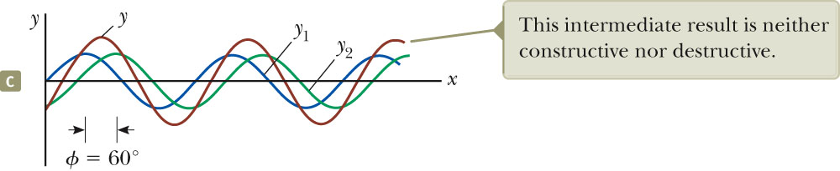
Sinusoidal Waves, General Interference
When φ is other than 0 or an even multiple of π, the amplitude of the resultant is between 0 and 2A.
The wave functions still add
The interference is neither constructive nor destructive.
Section 18.1

Slide 15
Sinusoidal Waves, Summary of Interference
Constructive interference occurs when φ = nπ where n is an even integer (including 0).
  Amplitude of the resultant is 2A
Destructive interference occurs when φ = nπ where n is an odd integer.
  Amplitude is 0
General interference occurs when 0 < φ < nπ.
  Amplitude is 0 < A_{resultant} < 2A
Section 18.1

Slide 16
Sinusoidal Waves, Interference with Difference Amplitudes
Constructive interference occurs when φ = n π where n is an even integer (including 0).
  Amplitude of the resultant is the sum of the amplitudes of the waves
Destructive interference occurs when φ = n π where n is an odd integer.
  Amplitude is less, but the amplitudes do not completely cancel
Section 18.1

Slide 17
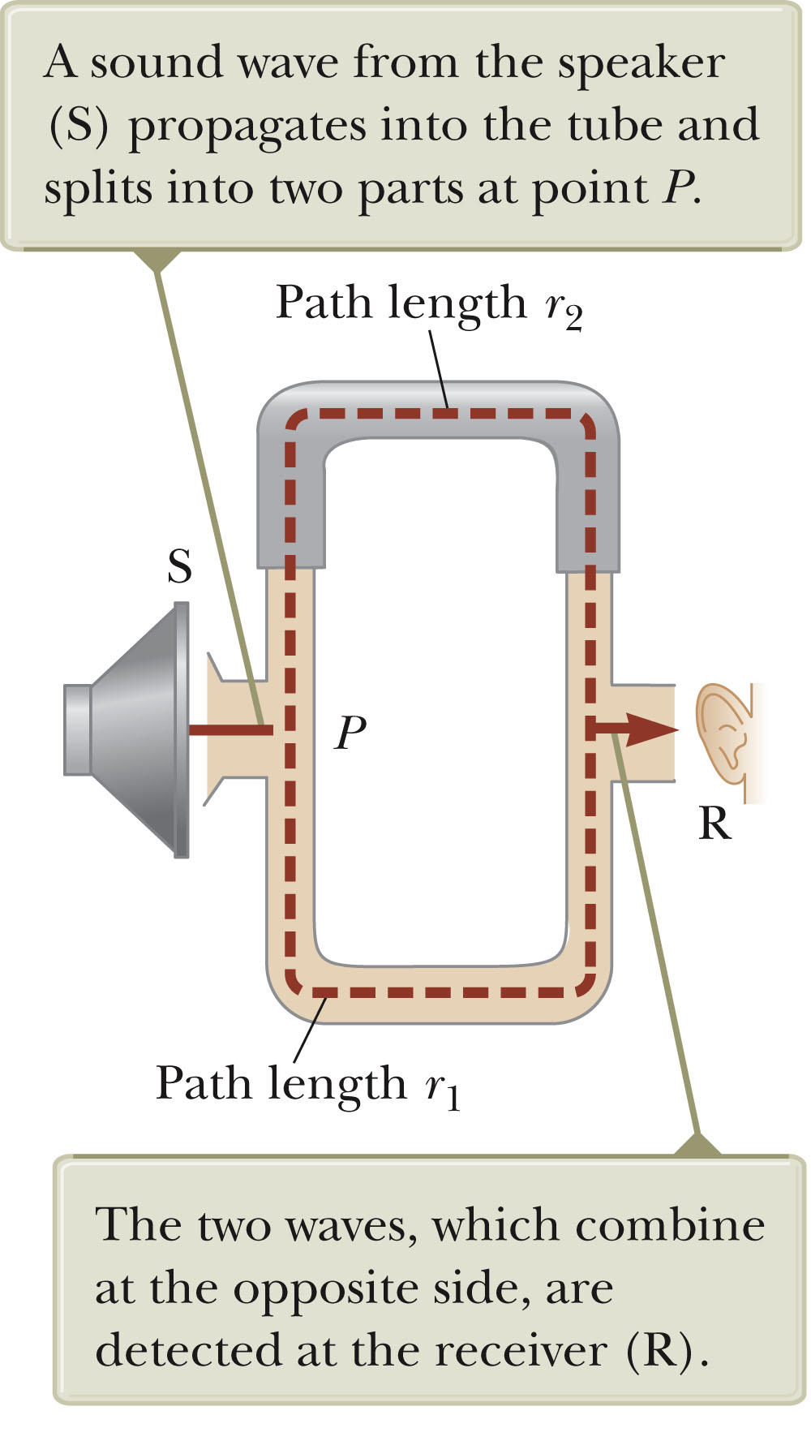
Interference in Sound Waves
Sound from S can reach R by two different paths.
The distance along any path from speaker to receiver is called the path length, r.
The lower path length, r₁, is fixed.
The upper path length, r₂, can be varied.
Whenever Δr = |r₂ – r₁| = n λ, constructive interference occurs.
  n = 0, 1, …
A maximum in sound intensity is detected at the receiver.
Section 18.1

Slide 18
Interference in Sound Waves, 2
Whenever Δr = |r₂ – r₁| = (nλ)/2 (n is odd), destructive interference occurs.
No sound is detected at the receiver.
A phase difference may arise between two waves generated by the same source when they travel along paths of unequal lengths.
Section 18.1

Slide 19
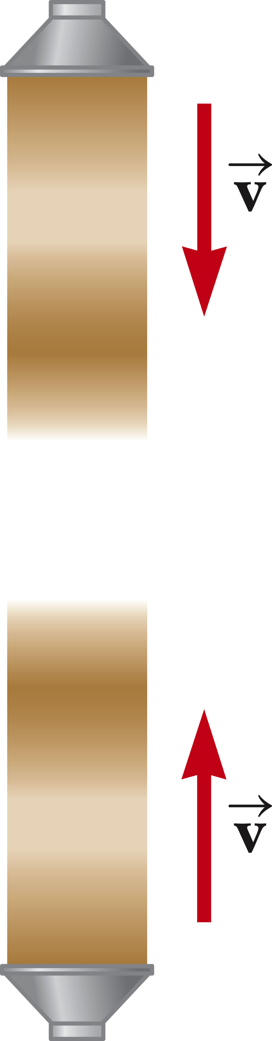
Standing Waves
Assume two waves with the same amplitude, frequency and wavelength, traveling in opposite directions in a medium.
The waves combine in accordance with the waves in interference model.
y₁ = A sin (kx – ωt) and
y₂ = A sin (kx + ωt)
They interfere according to the superposition principle.
Section 18.2

Slide 20
Standing Waves, cont
The resultant wave will be y = (2A sin kx) cos ωt.
This is the wave function of a standing wave.
  There is no kx – ωt term, and therefore it is not a traveling wave.
In observing a standing wave, there is no sense of motion in the direction of propagation of either of the original waves.
Section 18.2

Slide 21
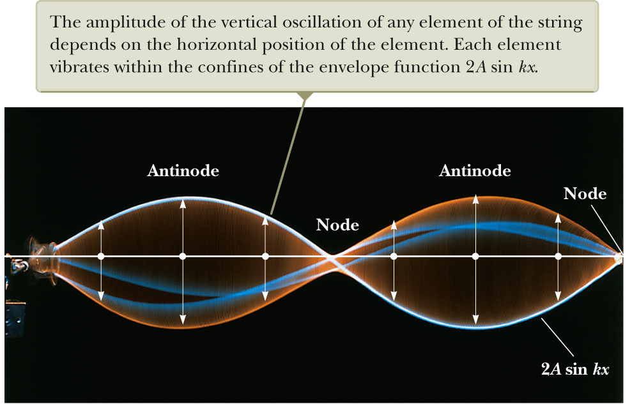
Standing Wave Example
Note the stationary outline that results from the superposition of two identical waves traveling in opposite directions.
The amplitude of the simple harmonic motion of a given element is 2A sin kx.
  This depends on the location x of the element in the medium.
Each individual element vibrates at ω.
Section 18.2

Slide 22
Note on Amplitudes
There are three types of amplitudes used in describing waves.
  The amplitude of the individual waves, A
  The amplitude of the simple harmonic motion of the elements in the medium,
    2A sin kx
    A given element in the standing wave vibrates within the constraints of the envelope function 2 A sin k x.
  The amplitude of the standing wave, 2A
Section 18.2

Slide 23
Standing Waves, Definitions
A node occurs at a point of zero amplitude.
  These correspond to positions of x where
An antinode occurs at a point of maximum displacement, 2A.
  These correspond to positions of x where
Section 18.2

Slide 24
Features of Nodes and Antinodes
The distance between adjacent antinodes is λ/2.
The distance between adjacent nodes is λ/2.
The distance between a node and an adjacent antinode is λ/4.
Section 18.2

Slide 25
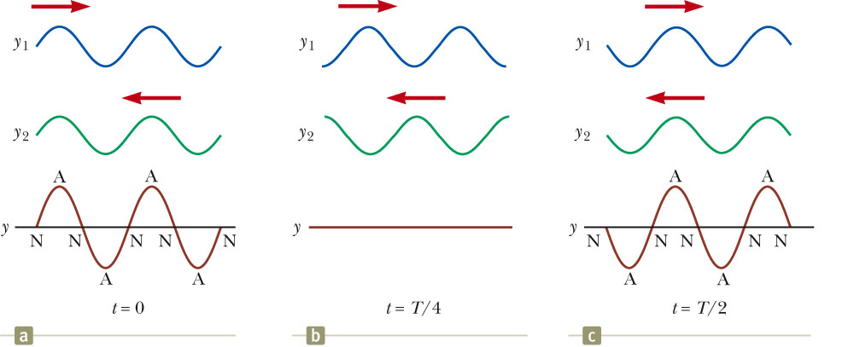
Nodes and Antinodes, cont
The diagrams above show standing-wave patterns produced at various times by two waves of equal amplitude traveling in opposite directions.
In a standing wave, the elements of the medium alternate between the extremes shown in (a) and (c).
Section 18.2

Slide 26
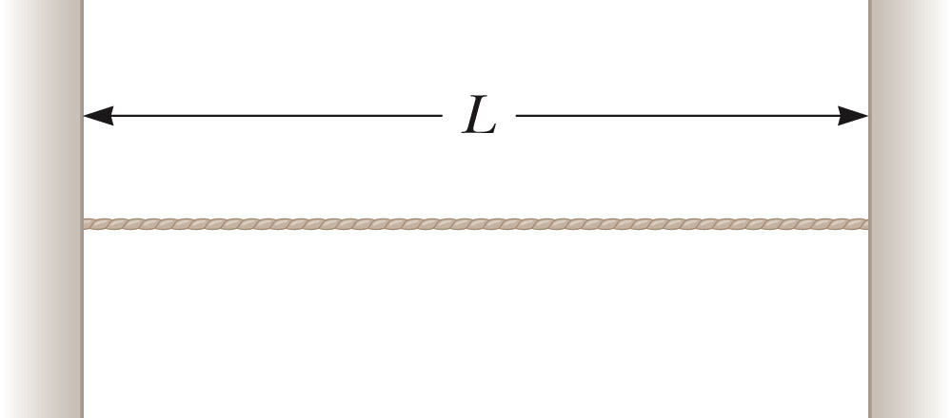
Standing Waves in a String
Consider a string fixed at both ends
The string has length L.
Waves can travel both ways on the string.
Standing waves are set up by a continuous superposition of waves incident on and reflected from the ends.
There is a boundary condition on the waves.
The ends of the strings must necessarily be nodes.
  They are fixed and therefore must have zero displacement.
Section 18.3

Slide 27
Standing Waves in a String, 2
The boundary condition results in the string having a set of natural patterns of oscillation, called normal modes.
  Each mode has a characteristic frequency.
    This situation in which only certain frequencies of oscillations are allowed is called quantization.
  The normal modes of oscillation for the string can be described by imposing the requirements that the ends be nodes and that the nodes and antinodes are separated by l/4.
We identify an analysis model called waves under boundary conditions.
Section 18.3

Slide 28
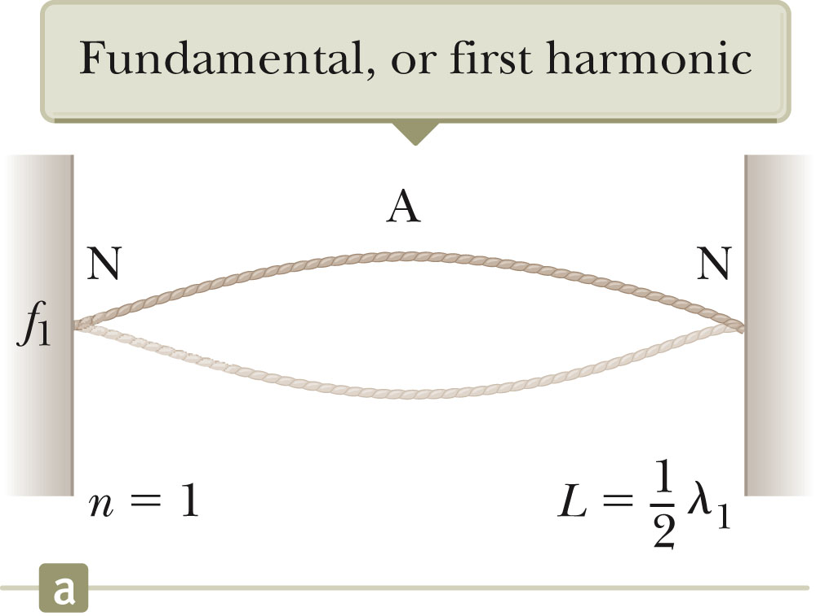
Standing Waves in a String, 3
This is the first normal mode that is consistent with the boundary conditions.
There are nodes at both ends.
There is one antinode in the middle.
This is the longest wavelength mode:
  ½λ₁ = L so λ₁ = 2L
The section of the standing wave between nodes is called a loop.
In the first normal mode, the string vibrates in one loop.
Section 18.3

Slide 29
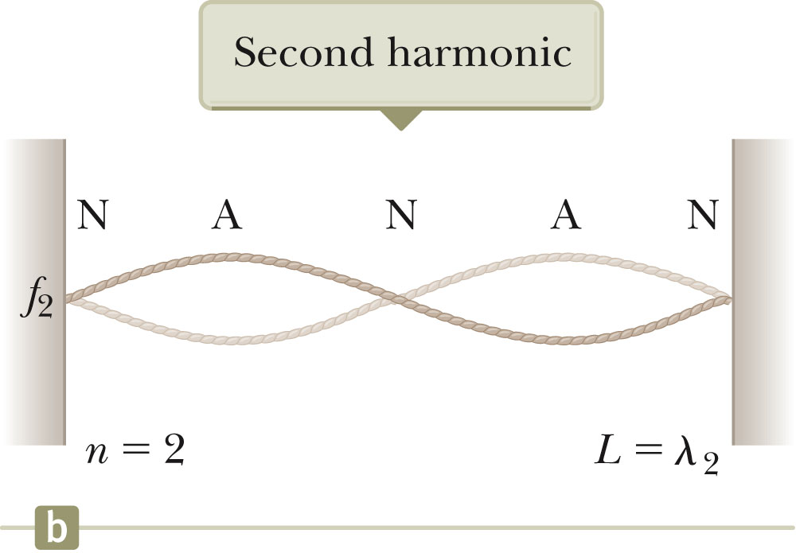
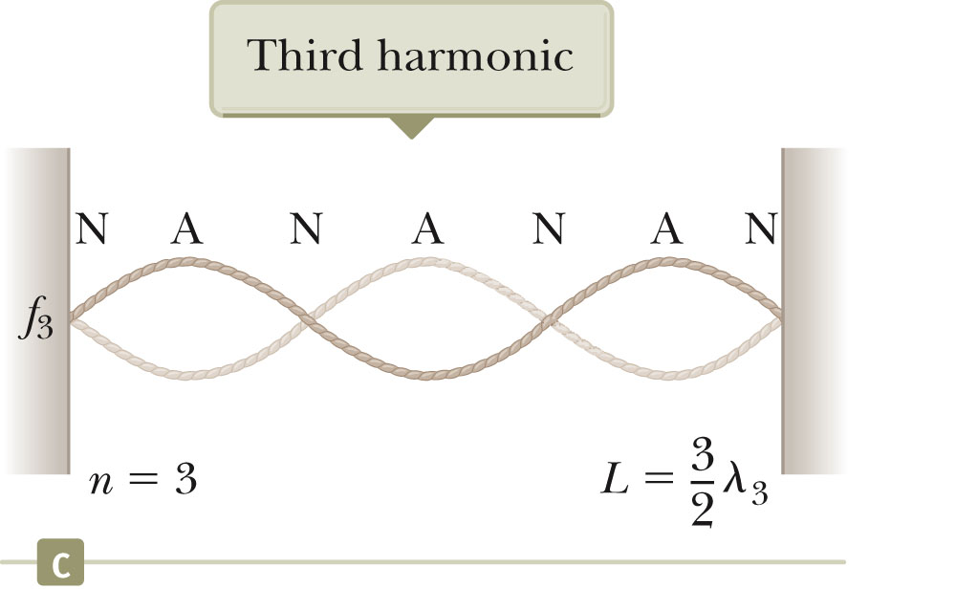
Standing Waves in a String, 4
Consecutive normal modes add a loop at each step.
  The section of the standing wave from one node to the next is called a loop.
The second mode (c) corresponds to to λ = L.
The third mode (d) corresponds to λ = 2L/3.
Section 18.3

Slide 30
Standing Waves on a String, Summary
The wavelengths of the normal modes for a string of length L fixed at both ends are λ_{n} = 2L / n n = 1, 2, 3, …
  n is the n^{th} normal mode of oscillation
  These are the possible modes for the string:
The natural frequencies are
  Also called quantized frequencies
Section 18.3

Slide 31
Waves on a String, Harmonic Series
The fundamental frequency corresponds to n = 1.
  It is the lowest frequency, ƒ₁
The frequencies of the remaining natural modes are integer multiples of the fundamental frequency.
  ƒ_{n} = nƒ₁
Frequencies of normal modes that exhibit this relationship form a harmonic series.
The normal modes are called harmonics.
Section 18.3

Slide 32
Musical Note of a String
The musical note is defined by its fundamental frequency.
The frequency of the string can be changed by changing either its length or its tension.
Section 18.3

Slide 33
Harmonics, Example
A middle “C” string on a piano has a fundamental frequency of 262 Hz. What are the next two harmonics of this string?
  ƒ₁ = 262 Hz
  ƒ₂ = 2ƒ₁ = 524 Hz
  ƒ₃ = 3ƒ₁ = 786 Hz
Section 18.3

Slide 34
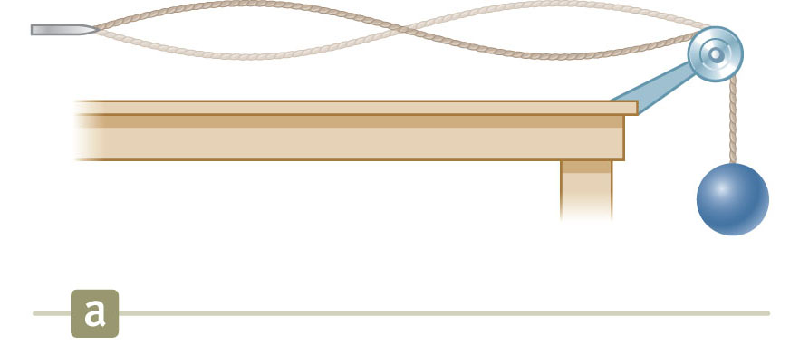
Standing Wave on a String, Example Set-Up
One end of the string is attached to a vibrating blade.
The other end passes over a pulley with a hanging mass attached to the end.
  This produces the tension in the string.
The string is vibrating in its second harmonic.
Section 18.3

Slide 35
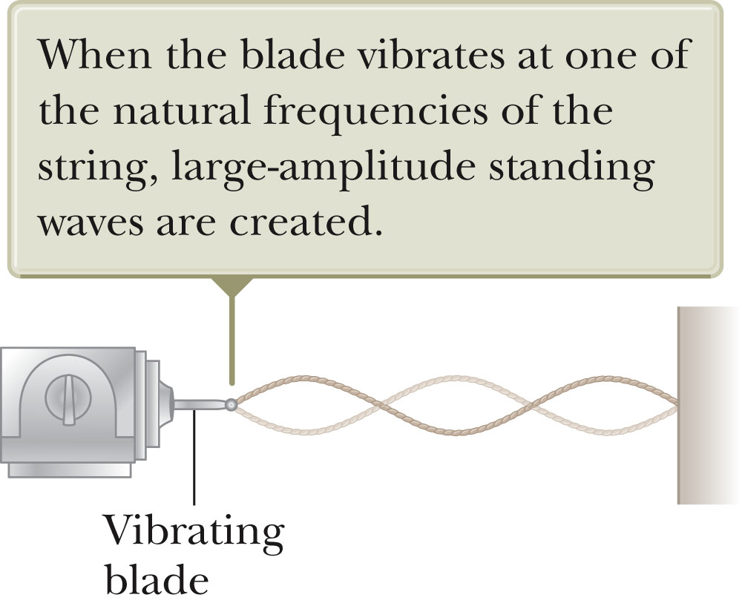
Resonance
A system is capable of oscillating in one or more normal modes.
Assume we drive a string with a vibrating blade.
If a periodic force is applied to such a system, the amplitude of the resulting motion of the string is greatest when the frequency of the applied force is equal to one of the natural frequencies of the system.
This phenomena is called resonance.
Section 18.4

Slide 36
Resonance, cont.
Because an oscillating system exhibits a large amplitude when driven at any of its natural frequencies, these frequencies are referred to as resonance frequencies.
If the system is driven at a frequency that is not one of the natural frequencies, the oscillations are of low amplitude and exhibit no stable pattern.
Section 18.4

Slide 37
Standing Waves in Air Columns
Standing waves can be set up in air columns as the result of interference between longitudinal sound waves traveling in opposite directions.
The phase relationship between the incident and reflected waves depends upon whether the end of the pipe is opened or closed.
Waves under boundary conditions model can be applied.
Section 18.5

Slide 38
Standing Waves in Air Columns, Closed End
A closed end of a pipe is a displacement node in the standing wave.
  The rigid barrier at this end will not allow longitudinal motion in the air.
The closed end corresponds with a pressure antinode.
  It is a point of maximum pressure variations.
  The pressure wave is 90º out of phase with the displacement wave.
Section 18.5

Slide 39
Standing Waves in Air Columns, Open End
The open end of a pipe is a displacement antinode in the standing wave.
  As the compression region of the wave exits the open end of the pipe, the constraint of the pipe is removed and the compressed air is free to expand into the atmosphere.
The open end corresponds with a pressure node.
  It is a point of no pressure variation.
Section 18.5

Slide 40
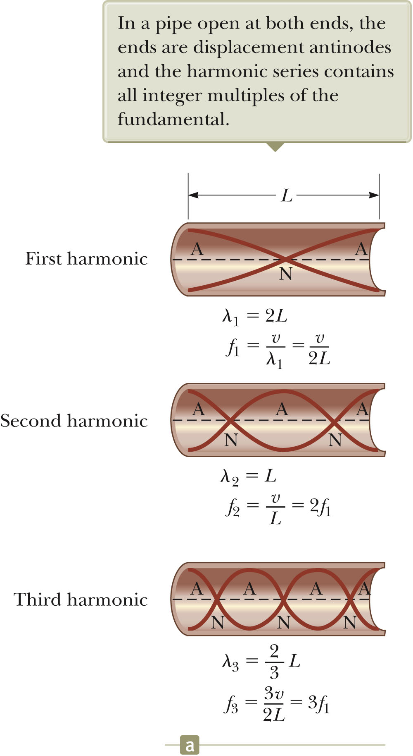
Standing Waves in an Open Tube
Both ends are displacement antinodes.
The fundamental frequency is v/2L.
  This corresponds to the first diagram.
The higher harmonics are ƒ_{n} = nƒ₁ = n (v/2L) where n = 1, 2, 3, …
In a pipe open at both ends, the natural frequencies of oscillation form a harmonic series that includes all integral multiples of the fundamental frequency.
Section 18.5

Slide 41
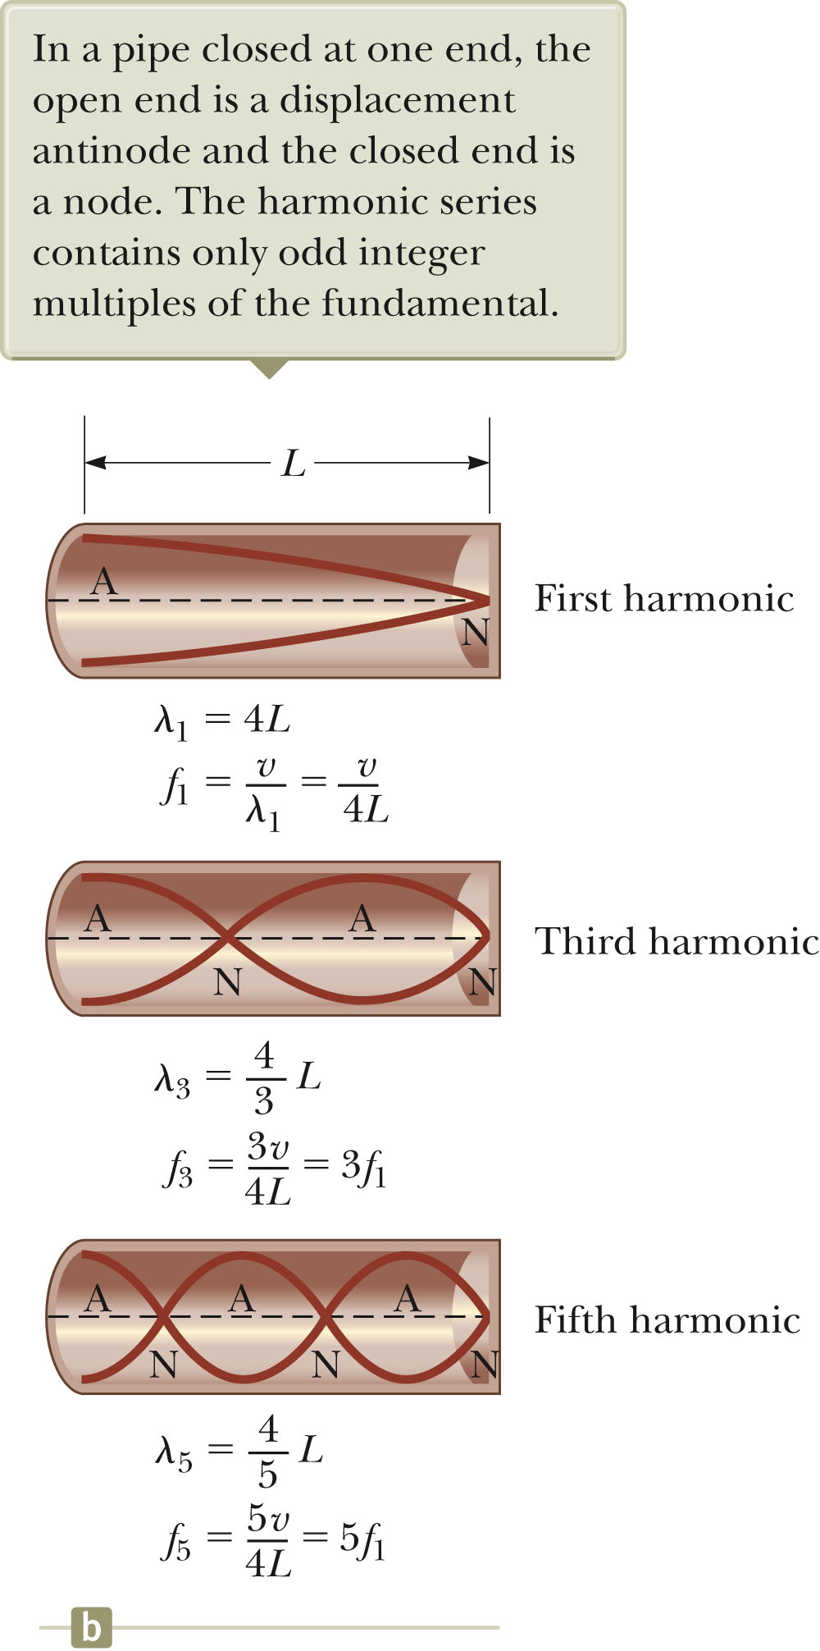
Standing Waves in a Tube Closed at One End
The closed end is a displacement node.
The open end is a displacement antinode.
The fundamental corresponds to ¼λ.
The frequencies are ƒ_{n} = nƒ = n (v/4L) where n = 1, 3, 5, …
In a pipe closed at one end, the natural frequencies of oscillation form a harmonic series that includes only odd integral multiples of the fundamental frequency.
Section 18.5

Slide 42
Notes About Musical Instruments
As the temperature rises:
  Sounds produced by air columns become sharp
    Higher frequency
    Higher speed due to the higher temperature
  Sounds produced by strings become flat
    Lower frequency
    The strings expand due to the higher temperature.
    As the strings expand, their tension decreases.
Section 18.5

Slide 43
More About Musical Instruments
Musical instruments based on air columns are generally excited by resonance.
The air column is presented with a sound wave rich in many frequencies.
The sound is provided by:
  A vibrating reed in woodwinds
  Vibrations of the player’s lips in brasses
  Blowing over the edge of the mouthpiece in a flute
Section 18.5

Slide 44
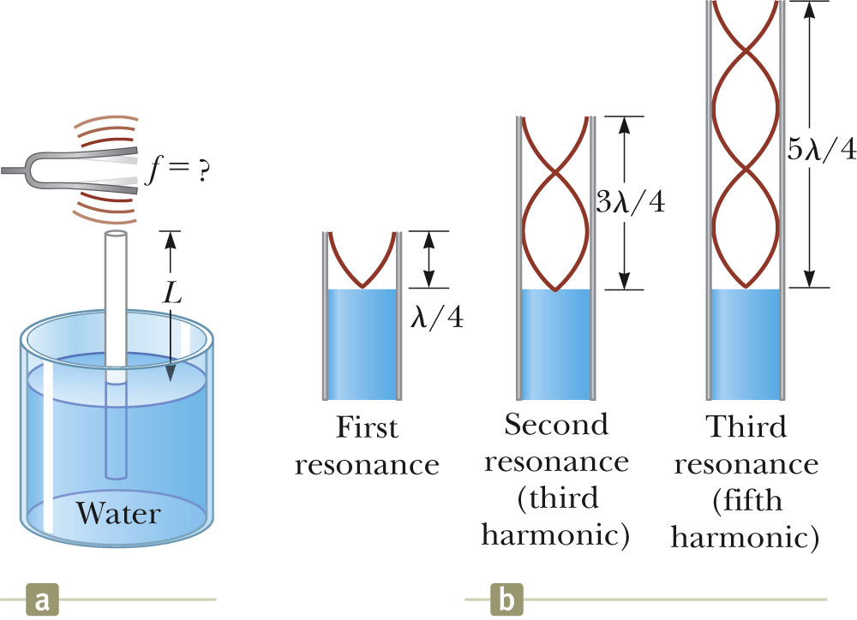
Resonance in Air Columns, Example
A tuning fork is placed near the top of the tube.
When L corresponds to a resonance frequency of the pipe, the sound is louder.
The water acts as a closed end of a tube.
The wavelengths can be calculated from the lengths where resonance occurs.
Section 18.5

Slide 45
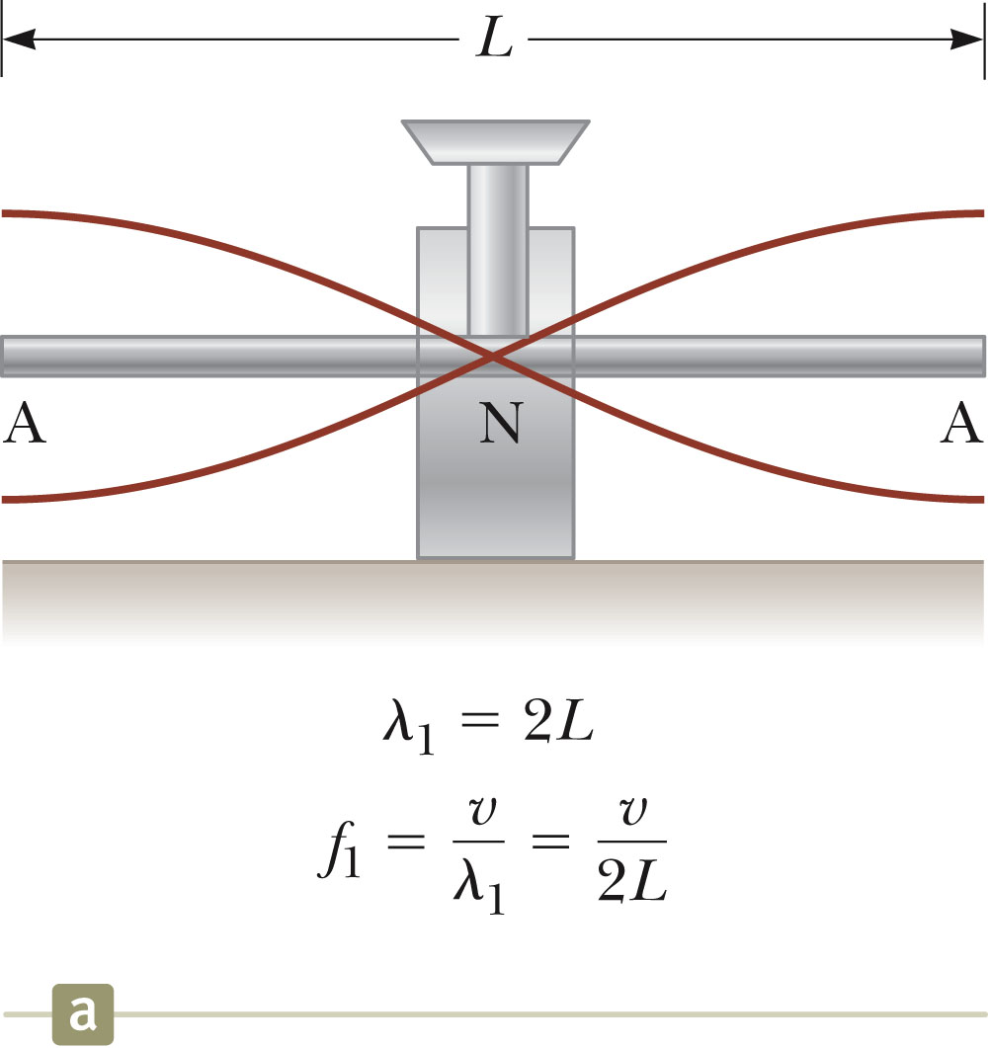
Standing Waves in Rods
A rod is clamped in the middle.
It is stroked parallel to the rod.
The rod will oscillate.
The oscillations of the elements of the rod are longitudinal.
The clamp forces a displacement node.
The ends of the rod are free to vibrate and so will correspond to displacement antinodes.
The first normal mode (shown) has a wavelength of 2 L and a frequency of ƒ = v / 2 L.
Section 18.6

Slide 46
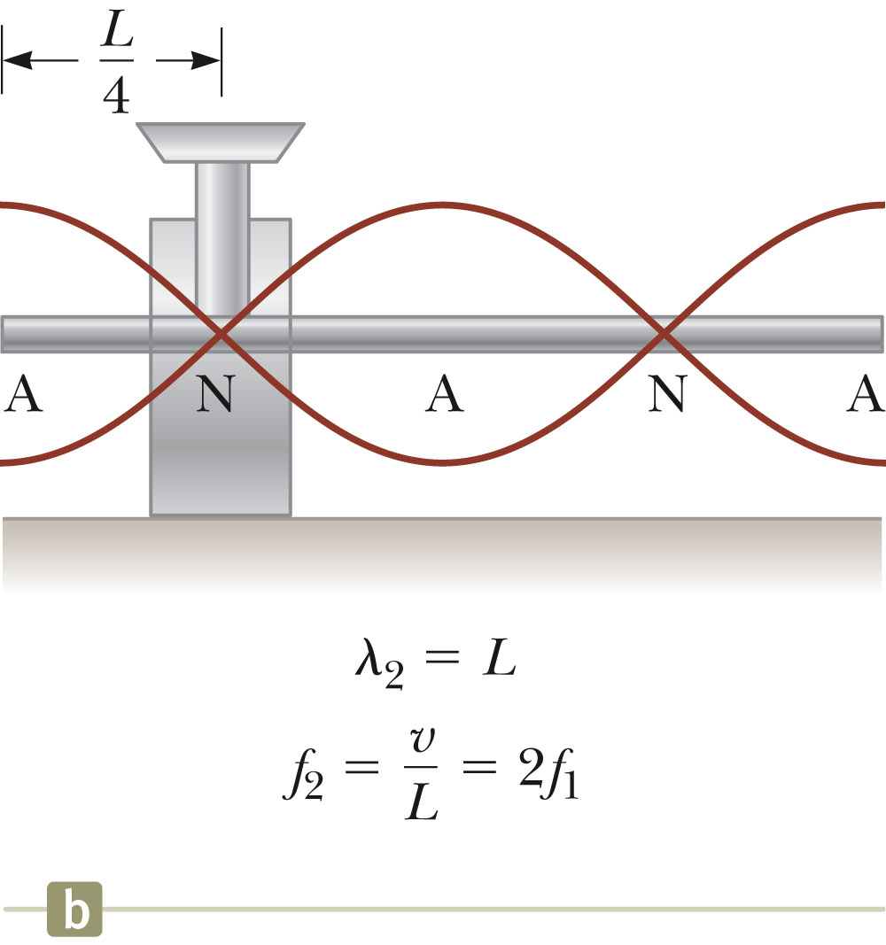
Standing Waves in Rods, cont.
By clamping the rod at other points, other normal modes of oscillation can be produced.
Here the rod is clamped at L/4 from one end.
This produces the second normal mode.
Section 18.6

Slide 47
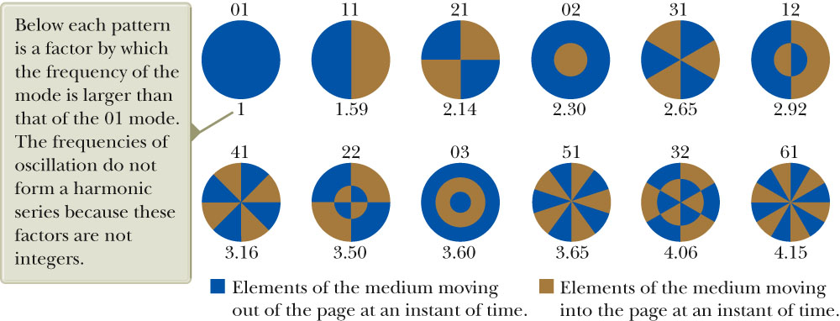
Standing Waves in Membranes
Two-dimensional oscillations may be set up in a flexible membrane stretched over a circular hoop.
The resulting sound is not harmonic because the standing waves have frequencies that are not related by integer multiples.
  The sound may be more correctly described as noise instead of music.
The fundamental frequency contains one nodal curve.
Section 18.6

Slide 48
Spatial and Temporal Interference
Spatial interference occurs when the amplitude of the oscillation in a medium varies with the position in space of the element.
  This is the type of interference discussed so far.
Temporal interference occurs when waves are periodically in and out of phase.
  This is a superposition of two waves having slightly different frequencies.
  There is a temporal alternation between constructive and destructive interference.
Section 18.7

Slide 49
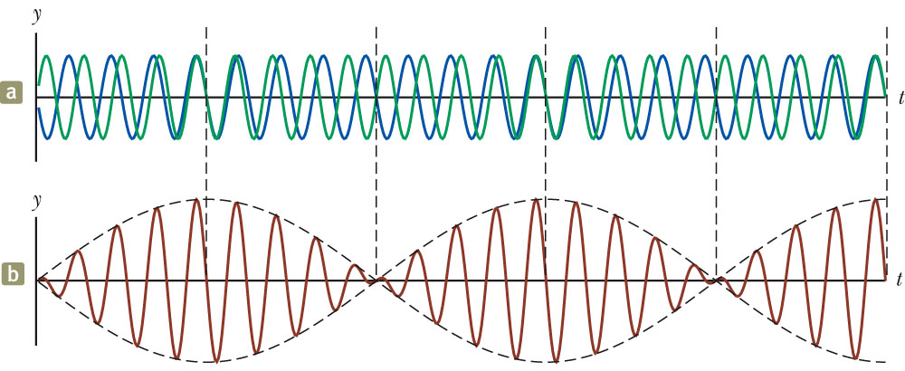
Beats and Beat Frequency
Beating is the periodic variation in amplitude at a given point due to the superposition of two waves having slightly different frequencies.
The number of amplitude maxima one hears per second is the beat frequency.
It equals the difference between the frequencies of the two sources.
The human ear can detect a beat frequency up to about 20 beats/sec.

Slide 50
Beats, Equations
The amplitude of the resultant wave varies in time according to
  Therefore, the intensity also varies in time.
The beat frequency is ƒ_{beat} = |ƒ₁ – ƒ₂|.
Section 18.7

Slide 51
Non-sinusoidal Wave Patterns
The wave patterns produced by a musical instrument are the result of the superposition of various harmonics.
The human perceptive response to a sound that allows one to place the sound on a scale of high to low is the pitch of the sound.
  Pitch vs. frequency
    Frequency is the physical measurement of the number of oscillations per second.
    Pitch is a psychological reaction to the sound.
    Frequency is the stimulus and pitch is the response.
The human perceptive response associated with the various mixtures of harmonics is the quality or timbre of the sound.
Section 18.8

Slide 52
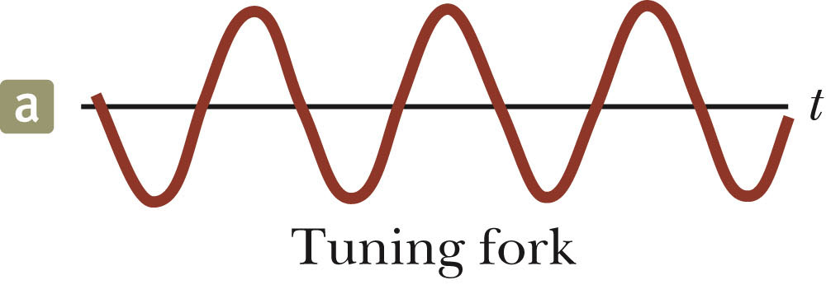
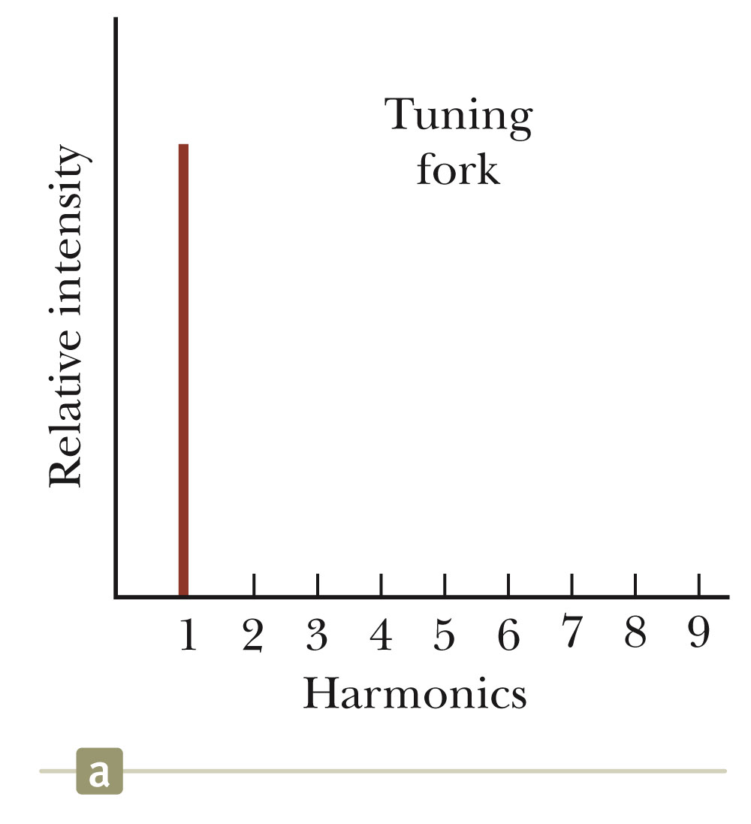
Quality of Sound – Tuning Fork
A tuning fork produces only the fundamental frequency.
Section 18.8

Slide 53
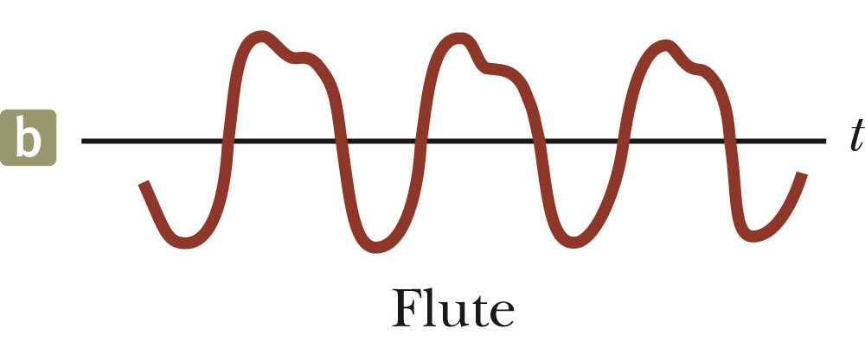
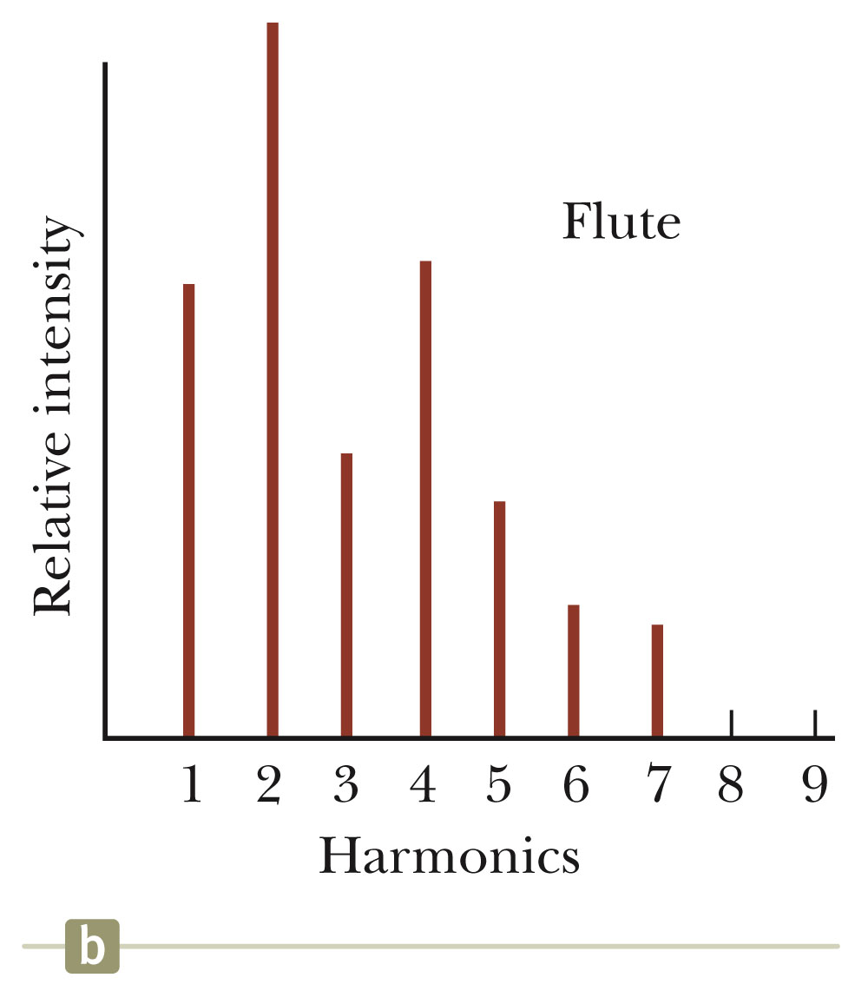
Quality of Sound – Flute
The same note played on a flute sounds differently.
The second harmonic is very strong.
The fourth harmonic is close in strength to the first.
Section 18.8

Slide 54
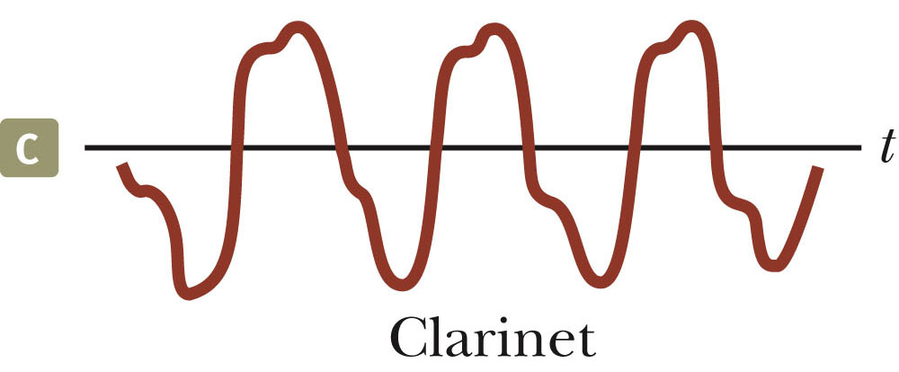
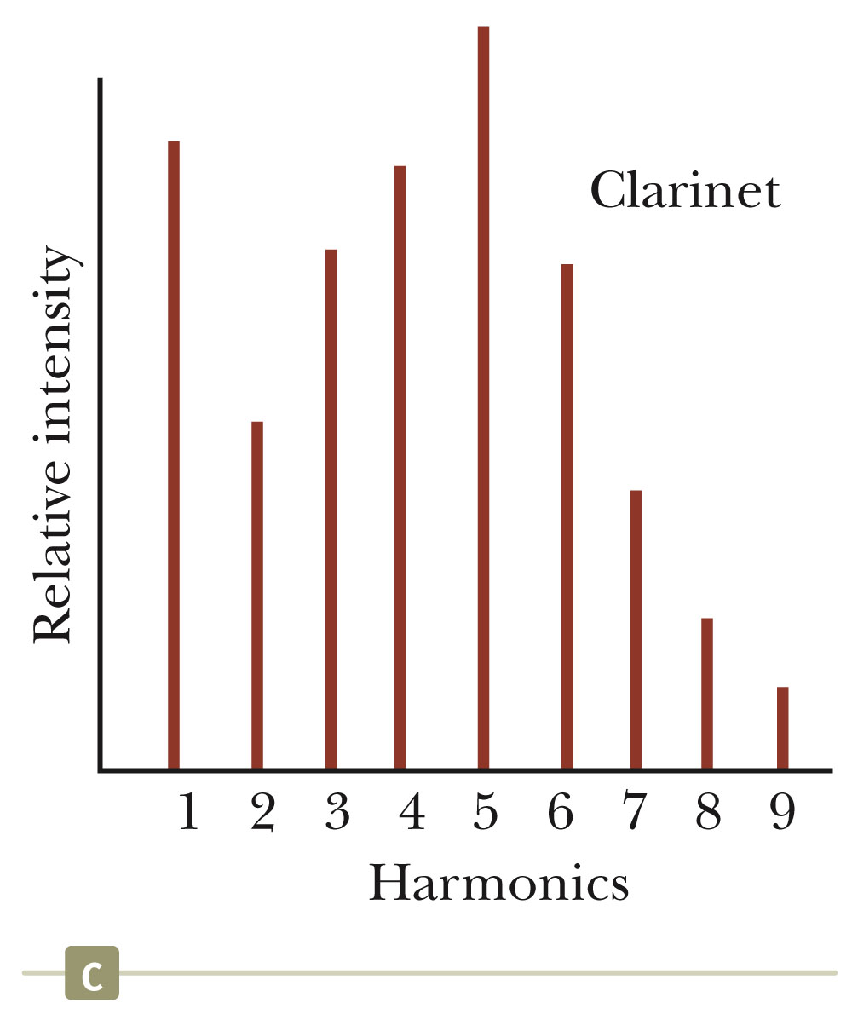
Quality of Sound – Clarinet
The fifth harmonic is very strong.
The first and fourth harmonics are very similar, with the third being close to them.
Section 18.8

Slide 55
Analyzing Non-sinusoidal Wave Patterns
If the wave pattern is periodic, it can be represented as closely as desired by the combination of a sufficiently large number of sinusoidal waves that form a harmonic series.
Any periodic function can be represented as a series of sine and cosine terms.
  This is based on a mathematical technique called Fourier’s theorem.
A Fourier series is the corresponding sum of terms that represents the periodic wave pattern.
If we have a function y that is periodic in time, Fourier’s theorem says the function can be written as:
  ƒ₁ = 1/T and ƒ_{n}= nƒ₁
  A_{n} and B_{n} are amplitudes of the waves.
Section 18.8

Slide 56
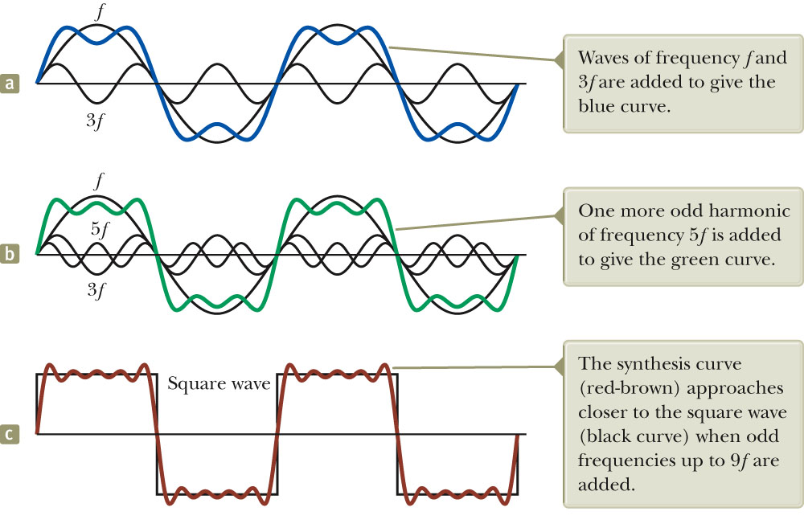
Fourier Synthesis of a Square Wave
In Fourier synthesis, various harmonics are added together to form a resultant wave pattern.
Fourier synthesis of a square wave, which is represented by the sum of odd multiples of the first harmonic, which has frequency f.
In (a) waves of frequency f and 3f are added.
In (b) the harmonic of frequency 5f is added.
In (c) the wave approaches closer to the square wave when odd frequencies up to 9f are added.
Section 18.8

